Slide 1
The Battle of Neighborhoods Final Presentation Adnan Shahin

Slide 2
Contents
Introduction Section :
1.1 Discussion of the "background situation" leading to the problem at hand:
1.2 Problem to be resolved
1.3 Audience for this project.
Data Section
2.1 Data of Current Situation (current residence place)
2.2 Data required to resolve the problem
2.3 Data sources and data manipulation
Methodology section
3.1 Process steps and strategy to resolve the problem
3.2 Data Science Methods, machine learing, mapping tools and exploratory data analysis.
Results Section
4.1 Discussion of the results and how they help to take a decision.
Discussion Section
5.1 Elaboration and discussion on any observations and/or recommendations for improvement.
Conclusion Section
6.1 Decision taken and Report Conclusion.

Slide 3
Introduction Section
1.1 Discussion of the "background situation" leading to the problem at hand:
Discussion of the business problem and the audience who would be interested in this project. 1.1 Scenario and Background I am a data scientist residing in Aachen, Germany. I currently live within walking distance to many ammenities and venues in the area, such as various international cousine restaurants, cafes, gyms,food shops and entertainment.
I have been offered a great opportunity to work in Aachen. Although, I am very excited about it, I am a bit stress toward the process to secure a comparable place to live in Aachen. Therefore, I decided to apply the learned skills during the Coursera course to explore ways to make sure my decision is factual and rewarding. Of course, there are alternatives to achieve the answer using available Google and Social media tools, but it rewarding doing it myself with learned tools.
1.2 Problem to be resolved: The challenge to resolve is being able to find an apartment unit in Aachen that offers similar characteristics and benefits to my current situation. Therefore, in order to set a basis for comparison, I want to place subject to the following conditions:
Top ammenities in the selected neighborhood shall be similar to current residence (See item 2.1) Desirable to have venues such as coffee shops, restaurants Asian Thai, wine stores, gym and food shops As a reference, I have included a map of venues near current residence in Aachen. 1.3 Interested Audience I believe this is a relevant project for a person or entity considering moving to a major city in Europe, US or Asia, since the approach and methodologies used here are applicable in all cases. The use of FourSquare data and mapping techniques combined with data analysis will help resolve the key questions arisen. Lastly, this project is a good practical case toward the development of Data Science skills.

Slide 4
Data section
Description of the data and its sources that will be used to solve the problem 2.1 Data of Current Situation
I Currently reside in the neighborhood of Aachen. I use Foursquare to identify the venues around the area of residence which are then shown in the New Delhi map shown in methodology and execution in section 3.0 . It serves as a reference for comparison with the desired future location in Koeln.
2.2 Data Required to resolve the problem
In order to make a good choice of a similar apartment in Koeln, the following data is required:
List/Information on neighborhoods form Koeln with their Geodata(latitude and longitude).
Venues and ammenities in the Koeln neighborhoods (e.g. top 10)
2.3 sources and manipulation
The list of Koeln neighborhoods is worked out during LAB exercise during the course. A csv file was created which will be read in order to create a dataframe and its mapping. The csv file 'mh_neigh_data.csv' has the following below data structure. The file will be directly read to the Jupiter Notebook for convenience and space savings. The clustering of neighborhoods and mapping will be shown however. An algorythm was used to determine the geodata from Nominatim . The actual algorythm coding may be shown in 'markdown' mode becasues it takes time to run.
2.4 How the data will be used to solve the problem The data will be used as follows:
Foursquare and geopy data to map top 10 venues for all Manhattan neighborhoods and clustered in groups ( as per Course LAB)
2.5 Mapping of Data
The following maps were created to facilitate the analysis and the choice of the palace to live.
Koeln map of Neighborhoods
Koeln map of clustered venues and neighborhoods.

Slide 5
Methodology section
This section represents the main component of the report where the data is gathered, prepared for analysis. The tools described are used here and the Notebook cells indicates the execution of steps.
The analysis and the stragegy: The strategy is based on mapping the above described data in section 2.0, in order to facilitate the choice of a candidate places for accomodation. The choice is made based on the demands imposed : similar venues to Dwarka, New Delhi, India. This visual approach and maps with popups labels allow quick identification of location, thus making the selection very easy.
The procesing of these DATA and its mapping will allow to answer the key questions to make a decision:
What are the venues of the best place to live? How venues distribute among Koeln neighborhoods ?

Slide 6
Methodology section
This section represents the main component of the report where the data is gathered, prepared for analysis. The tools described are used here and the Notebook cells indicates the execution of steps.
The analysis and the strategy: The strategy is based on mapping the above described data in section 2.0, in order to facilitate the choice of a candidate places for accommodation. The choice is made based on the demands imposed : similar venues to Aachen, Germany. This visual approach and maps with popups labels allow quick identification of location, thus making the selection very easy.
The processing of these DATA and its mapping will allow to answer the key questions to make a decision:
What are the venues of the best place to live? How venues distribute among Koeln neighborhoods ?

Slide 7
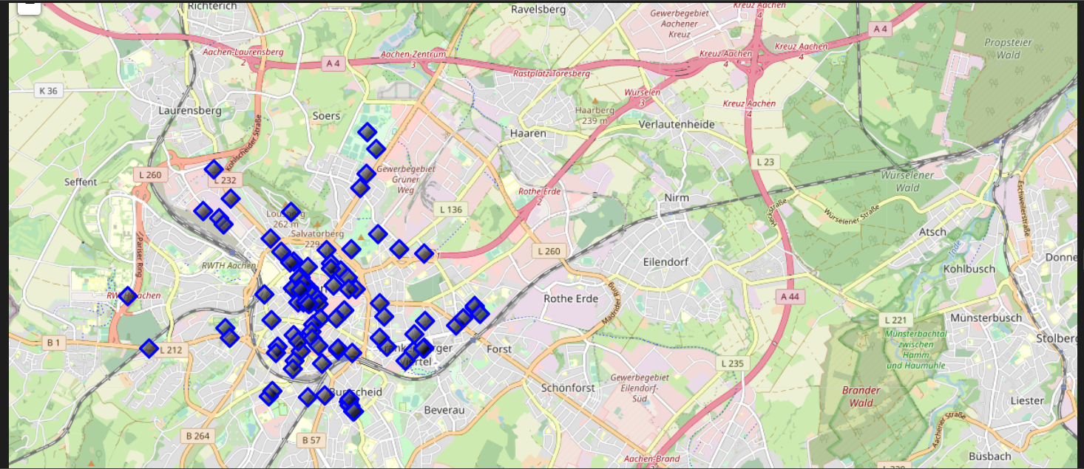
Map of Aachen residence place with venues in Neighborhood - for reference

Slide 8
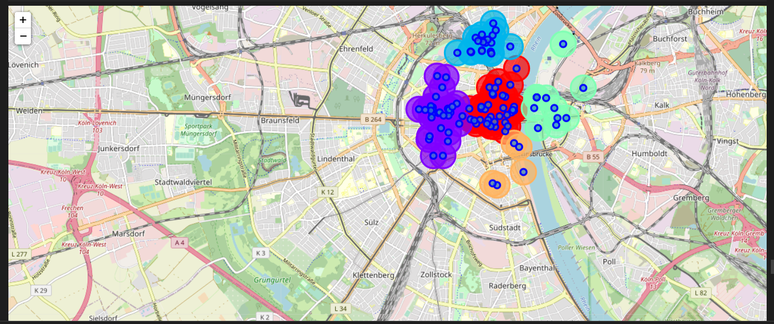
Map of Koeln using latitude and longitude values with clustering of venues

Slide 9
Resutls
ONE CONSOLIDATE MAP Let's consolidate all the required inforamtion to make the apartment selection in one map Map of Koeln with cluster of venues Bubbles are the clusters of venues

Slide 10
Discussion
In general, I am positively impressed with the overall organization, content and lab works presented during the Coursera IBM Certification Course I feel this Capstone project presented me a great opportunity to practice and apply the Data Science tools and methodologies learned. I have created a good project that I can present as an example to show my potential. I feel I have acquired a good starting point to become a professional Data Scientist and I will continue exploring to creating examples of practical cases.

Slide 11
CONCLUSIONS
I feel rewarded with the efforts, time and money spent. I believe this course with all the topics covered is well worthy of appreciation. This project has shown me a practical application to resolve a real situation that has impacting personal and financial impact using Data Science tools. The mapping with Folium is a very powerful technique to consolidate information and make the analysis and decision thoroughly and with confidence. I would recommend for use in similar situations. One must keep abreast of new tools for Data Science that continue to appear for application in several business fields.

Slide 12
End of Project and Course/ Thanks to Coursera Team and Students!. Happy 2021!!¶

